Slide 1
Cable Complaints
Big data analytics track Project – Submitted by Shalini gupta

Slide 2
Profile Details
Name: Shalini Gupta
Email ID: shalini2501@gmail.com
Course Enrolled: Big Data Analytics
Project Name: Cable Complaints

Slide 3
Project Details
Domain: Consumer Goods
Topic: Cable Complaints
Technology used: Hive on Hadoop

Slide 4
Project Introduction
Project is about analysing the data on cable complaints with Montgomery Country Cable Office.
Dataset: Cable_Complaints.csv
To start with the project, following commands are used to build the table in Hive:
create database bigdataProject;
use bigdataProject;
create table cable_table(DateofCompalint string, DateofClousre string, Street String, City String, State String, Zip String, CableProvider String, Billing int, Service int, Internet int, TelephoneAnswering int, Reception int, Construction int, Marketing int, Installation int, CableServiceAvailability int, CableLineRelated int, TelephoneService int, Other int, Type String, Location String) row format delimited fields terminated by ',' stored as textfile;

Slide 5
Project Introduction (Continue)
Uploaded the data in Hive database “bigdataproject.db” table “cable_table”, query used:
load data inpath '/user/shalini25012559/cable_complaints.csv' into table cable_table;
To clean the data, following command is used:
create table cable_tbl1 as select UNIX_TIMESTAMP(regexp_replace(dateofcompalint,'/','-'),'mm-dd-yyyy') as complaintdate, UNIX_TIMESTAMP(regexp_replace(dateofclousre,'/','-'),'mm-dd-yyyy') as clousredate, Street, City, State, Zip, CableProvider, Billing, Service, Internet, TelephoneAnswering, Reception, Construction,Marketing, Installation, CableServiceAvailability, CableLineRelated, TelephoneService, Other, Type, regexp_replace(location,'"','') as loc from cable_table;

Slide 6
DataSet Description
Meta Data:
ComplaintDate : timestamp
ClosureDate : timestamp
Street : String
City : String
State : String
ZIP : String
CableProvider : String
Billing : int
Service : int
Internet : int
TelephoneAnsweringTime : int
Reception : int
Construction : int
Marketing : int
Installation: int
CableServiceAvailability : int
CableLineRelated : int
TelephoneService : int
Other : int
Type : String
Loc: String (for location)

Slide 7
Business Questions Identified (Question 1)
Question 1: Display all the unique cable provider in city “Rockville”.
Approach:
To get the details of unique cable provider, query used:
Select distinct cableProvider from cable_tbl1 where city = "Rockville";
Findings:
On executing the above select query. I find 7 cable providers names.

Slide 8
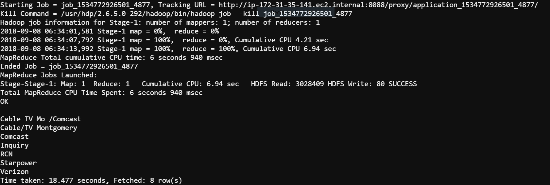
Business Questions Identified (Continued)
Visualization of question 1:

Slide 9
Business Questions Identified (Question 2)
Question 2: Display all the fields of the file whose location is starting from character 'C'.
Approach:
To get the details whose location is starting from character ‘C’, query used:
select * from cable_tbl1 where loc like'C%’;
Findings:
On executing the above select query. Number of fetched rows are 2399.

Slide 10
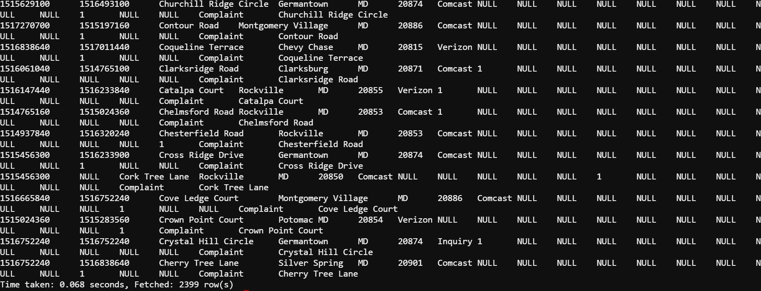
Business Questions Identified (Continued)
Visualization of question 2:

Slide 11
Business Questions Identified (Question 3)
Question 3: Count the number of internet complain in the city Ashton in the year 2008.
Approach:
To know about internet complaints in Ashton city in the year 2008, query used:
select internet,city,year(from_unixtime(complaintdate)) from cable_tbl1 where city = "Ashton" and year(from_unixtime(complaintdate)) = '2008' and internet is not null;
To know count of internet complaints in Ashton city in the year 2008, used count() function, query used:
select count(internet) from cable_tbl1 where city = "Ashton" and year(from_unixtime(complaintdate)) = '2008' and internet is not null;
Findings:
On first query execution, I find 5 records.
After executing second query, output is coming in 1 row and output is 5.

Slide 12
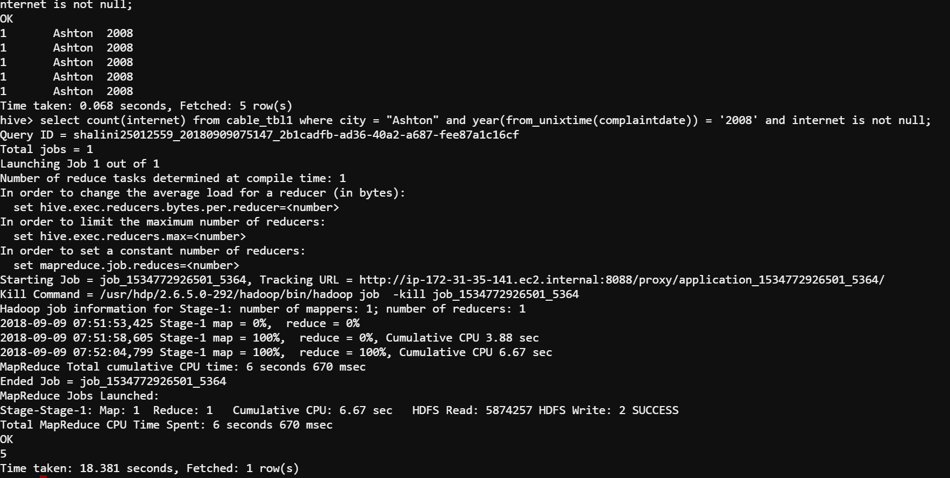
Business Questions Identified (Continued)
Visualization of question 3:

Slide 13
Business Questions Identified (Question 4)
Question 4: Display the cable provider, Zip code and city name for all those entries who have done inquiries.
Approach:
Query used:
Select cableProvider, zip, city from cable_tbl1 where cableProvider = "Inquiry";
Findings:
On query execution, I find 298 records.

Slide 14
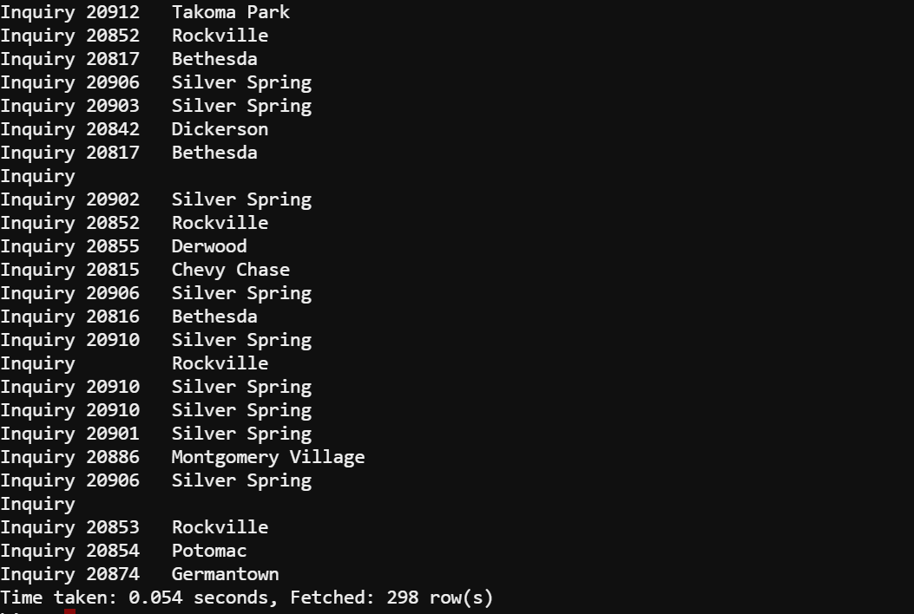
Business Questions Identified (Continued)
Visualization of question 4:

Slide 15
Business Questions Identified (Question 5)
Question 5:
A) For all the users who have done billing complaint, and marked it as 'Y' and store it in file.
B) For all the user who haven’t done any billing complaint and marked it as 'N' and store it in file.
Finally combine both the files and store the final result.

Slide 16
Business Questions Identified (Continued)
Approach:
For all the users who have done billing complaint, and marked it as 'Y' and store it in file,query used:
insert overwrite directory '/user/shalini25012559/bigdataProject/complaintY'
row format delimited fields terminated by ','
select complaintdate,clousredate,Street, City, State, Zip, CableProvider, regexp_replace(regexp_replace(Billing,'[0-9]*','Y'),'YY','Y') as newbilling, Service, Internet, TelephoneAnswering, Reception, Construction,Marketing, Installation, CableServiceAvailability, CableLineRelated, TelephoneService, Other, Type, loc from bigdataProject.cable_tbl1 where billing is not null and type = 'Complaint’;
In local file system:
hdfs dfs -get '/user/shalini25012559/bigdataProject/complaintY/*' .
cat 000000_0 > complaintY.csv

Slide 17
Business Questions Identified (Continued)
For all the user who haven’t done any billing complaint and marked it as 'N' and store it in file :
In local file system:
rm 000000_0
Query is used:
insert overwrite directory '/user/shalini25012559/bigdataProject/complaintN'
row format delimited fields terminated by ','
select complaintdate,clousredate,Street, City, State, Zip, CableProvider, coalesce(billing,'N') as newbilling, Service, Internet, TelephoneAnswering, Reception, Construction,Marketing, Installation, CableServiceAvailability, CableLineRelated, TelephoneService, Other, Type, loc from bigdataProject.cable_tbl1 where billing is null and type = "Complaint";

Slide 18
Business Questions Identified (Continued)
In local file system:
hdfs dfs -get '/user/shalini25012559/bigdataProject/complaintN/*' .
cat 000000_0 > complaintN.csv
For merging the two files, command used in local file system:
cat complaint* > combinedComplaintfile.csv

Slide 19
Business Questions Identified (Question 6)
Question 6: Find the top 5 shortest resolution time amongst all the complaints made in all the categories. Display all the fields.
Approach:
Query used:
select from_unixtime(complaintdate) as complaindate, from_unixtime(clousredate) as clousre,abs(datediff(from_unixtime(clousredate),from_unixtime(complaintdate))) as resolutiontime,Street, City, State, Zip, CableProvider,Billing, Service, Internet, TelephoneAnswering, Reception, Construction,Marketing, Installation, CableServiceAvailability, CableLineRelated, TelephoneService, Other, Type, loc as location from cable_tbl1 where type = "Complaint" and clousredate is not null and complaintdate is not null order by resolutiontime limit 5;

Slide 20
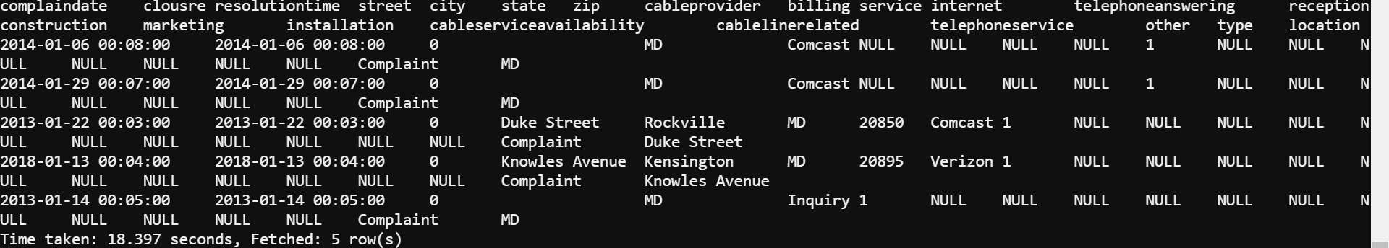
Business Questions Identified (Continued)
Visualization of question 6:

Slide 21
Thank you!

